Slide 1
WEB PROJECT
PROPOSAL
Here is where your presentation begins

Slide 2
TABLE OF CONTENTS
01
04
About the Project
Sneak Peek
02
05
Major Requirements
Project Stages
03
06
Project Goals
Our Team
Here you could describe
the topic of the section
Here you could describe
the topic of the section
Here you could describe
the topic of the section
Here you could describe
the topic of the section
Here you could describe
the topic of the section
Here you could describe
the topic of the section

Slide 3
OUR COMPANY
GOSTUDIO
Mercury is the closest planet to the Sun and the smallest one in the Solar System—it’s only a bit larger than our Moon. The planet’s name has nothing to do with the liquid metal since it was
named after the Roman messenger god, Mercury.

Slide 4
WHAT WE ARE WORKING ON
SECURE
ACCESSIBLE
FAST AND RELIABLE
Mercury is the closest planet to the Sun
Despite being red, Mars is a cold place, not hot
Neptune is the farthest planet from the Sun

Slide 5
ABOUT THE PROJECT
Mercury is the closest planet to the Sun and the smallest one in the Solar System—it’s only a bit larger than our Moon. The planet’s name has nothing to do with the liquid metal since it was named after the Roman messenger god, Mercury

Slide 6
—SOMEONE FAMOUS
“This is a quote. Words full of wisdom that someone important said and can make the reader get inspired.”

Slide 7
NOW
POOR DESIGN
PROGRAMMING MISTAKES
LACK OF ADAPTABILITY

Slide 8
FUTURE
BRANDING
POSITIONING
ADAPTABILITY

Slide 9
MAJOR REQUIREMENTS
IMAGES
USER EXPERIENCE
INFORMATION
Despite being red, Mars is a cold place, not hot. It’s full of iron oxide dust
Venus has a beautiful name and is the second planet from the Sun
Mercury is the closest planet to the Sun and the smallest in our Solar System

Slide 10
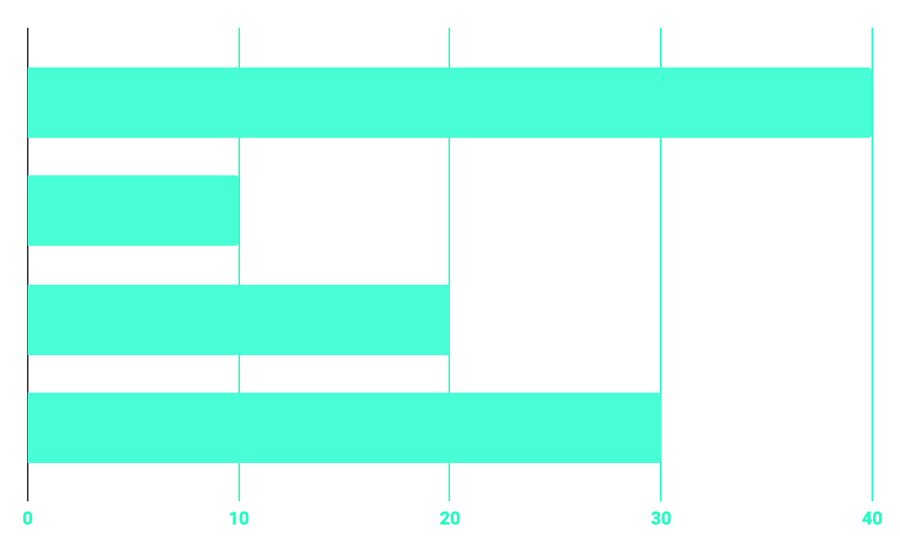
BUDGET
40%
20%
PROGRAMMING
10%
30%
DATABASE
WEB DESIGN
UX RESEARCH

Slide 11
OUR GOALS
EXPANSION
POSITIONING
USABILITY
Neptune is the fourth-largest planet in our Solar System
Venus has a beautiful name and is the second planet from the Sun
Despite being red, Mars is a cold place, not hot. It’s full of iron oxide dust

Slide 12
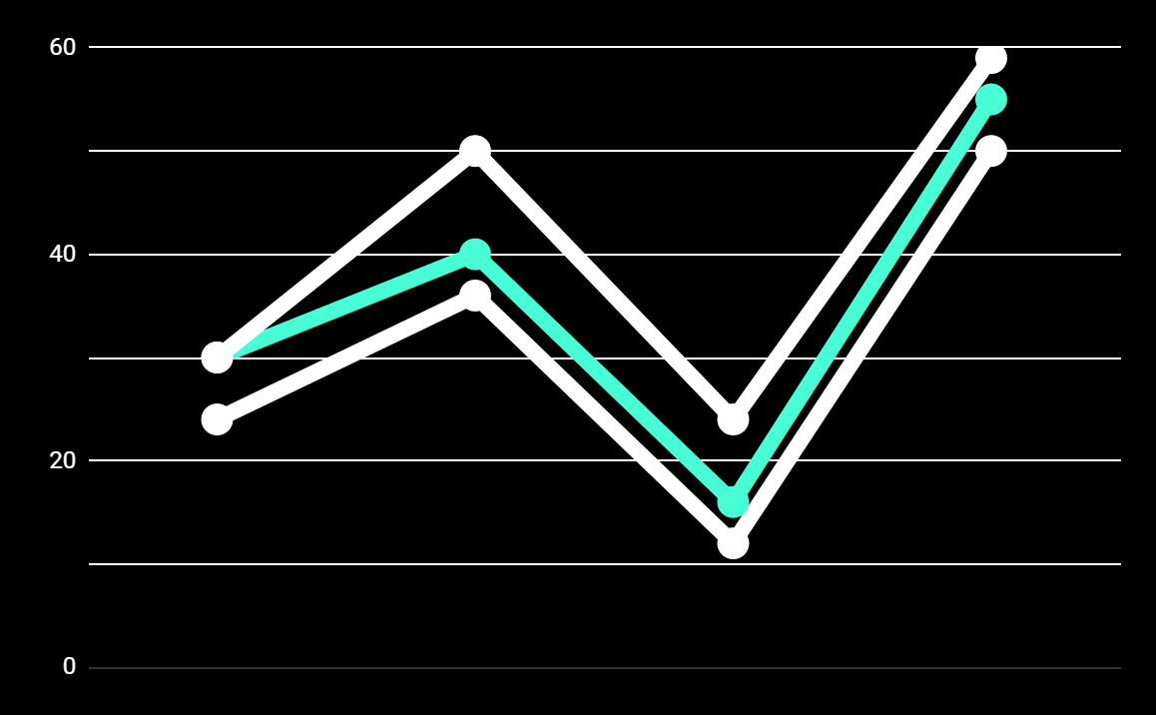
PREDICTED RESULTS
CONVERSIONS NEXT YEAR
+20%
MONTHLY VISITS
+33%
CONVERSION RATE
+40%
ANNUAL ORDERS

Slide 13
SNEAK PEEK
HEADER
TEXT
SLIDER
ICONS

Slide 14
A VIDEO IS A GOOD IDEA
Insert your multimedia content here

Slide 15
PROJECT STAGES
STEP 2
STEP 1
STEP 3
Venus has a beautiful name and is the second planet from the Sun
Despite being red, Mars is a cold place, not hot. It’s full of iron oxide dust
Saturn is a gas giant, composed mostly of hydrogen and helium

Slide 16
OUR TIMELINE
WEEK 1
WEEK 3
BETA
RELEASE
FINAL
VERSION
WEEK 2
WEEK 4
Improvements
Increased traffic
Focus group
Progress review

Slide 17
OUR PARTNERS
MARS
VENUS
MERCURY
Mercury is the closest planet to the Sun and the smallest one in our Solar System
Despite being red, Mars is a cold place, not hot. It’s full of iron oxide dust
Venus has a beautiful name and is the second planet from the Sun

Slide 18



THE TEAM
JENNA DOE
JOHN DOE
JIMMY DOE
You can replace the image on the screen with your own
You can replace the image on the screen with your own
You can replace the image on the screen with your own

Slide 19
THANKS!
Does anyone have any question?
addyouremail@freepik.com
+91 620 421 838
yourcompany.com

Slide 20
CREDITS
This is where you give credit to the ones who are part of this project.
Presentation template by Slidesgo
Icons by Flaticon
Infographics by Freepik
Images created by Freepik
Author introduction slide photo created by Freepik
Text & Image slide photo created by Freepik

Slide 21
RESOURCES
Did you like the resources on this template? Get them for free at our other websites.
PHOTOS
Young businessman with hands in his pocket talking on mobile phone
Smiling ethnic woman with gray laptop
Smiling young man busy in texting message to someone
VECTORS
Flat computer engineering concept
Circuit of user experience
Timeline infographic
Logotype collection
Flat social media multimedia player templa
Gradient technology logo template collection
Digital marketing landing page template
Colorful responsive landing page
Modern web design concept with hand drawn style
App development concept with flat design

Slide 22
Instructions for use
In order to use this template, you must credit Slidesgo by keeping the Thanks slide.
You are allowed to:
- Modify this template.
- Use it for both personal and commercial projects.
You are not allowed to:
- Sublicense, sell or rent any of Slidesgo Content (or a modified version of Slidesgo Content).
- Distribute Slidesgo Content unless it has been expressly authorized by Slidesgo.
- Include Slidesgo Content in an online or offline database or file.
- Offer Slidesgo templates (or modified versions of Slidesgo templates) for download.
- Acquire the copyright of Slidesgo Content.
For more information about editing slides, please read our FAQs:
https://slidesgo.com/faqs

Slide 23
Fonts & colors used
This presentation has been made using the following fonts:
Roboto
(https://fonts.google.com/specimen/Roboto+bold)
Roboto
(https://fonts.google.com/specimen/Roboto+Thin)
#48ffd5
#0e2a47
#ffffff

Slide 24
Storyset
Create your Story with our illustrated concepts. Choose the style you like the most, edit its colors, pick the background and layers you want to show and bring them to life with the animator panel! It will boost your presentation. Check out How it Works.
Pana
Amico
Bro
Rafiki
Cuate

Slide 25
Use our editable graphic resources...
You can easily resize these resources without losing quality. To change the color, just ungroup the resource and click on the object you want to change. Then, click on the paint bucket and select the color you want. Group the resource again when you’re done. You can also look for more infographics on Slidesgo.

Slide 28
JANUARY
FEBRUARY
MARCH
APRIL
MAY
JUNE
PHASE 1
Task 1
Task 2
PHASE 2
Task 1
Task 2
JANUARY
FEBRUARY
MARCH
APRIL
PHASE 1
Task 1
Task 2

Slide 31
...and our sets of editable icons
You can resize these icons without losing quality.
You can change the stroke and fill color; just select the icon and click on the paint bucket/pen.
In Google Slides, you can also use Flaticon’s extension, allowing you to customize and add even more icons.

Slide 32
Educational Icons
Medical Icons

Slide 33
Business Icons
Teamwork Icons

Slide 34
Help & Support Icons
Avatar Icons

Slide 35
Creative Process Icons
Performing Arts Icons

Slide 36
Nature Icons

Slide 37
SEO & Marketing Icons

Slide 38


